Slide 1
COVID-19 in Boone County and how you can help
Albert Hsu, MD
President-elect, Boone County Medical Society
April 1, 2020

Slide 2
Disclosures / Disclaimers
Please understand that this information is constantly-evolving.
Pandemics are difficult to model and predict.
Some “facts” stated just last week, may now already be out-of-date.
I AM NOT YOUR DOCTOR.
Please see your primary care provider for any personal medical questions.
Today’s town hall is a general informational session to the Mizzou student community.
I will direct you to official websites (like CDC) for public health recommendations.

Slide 3
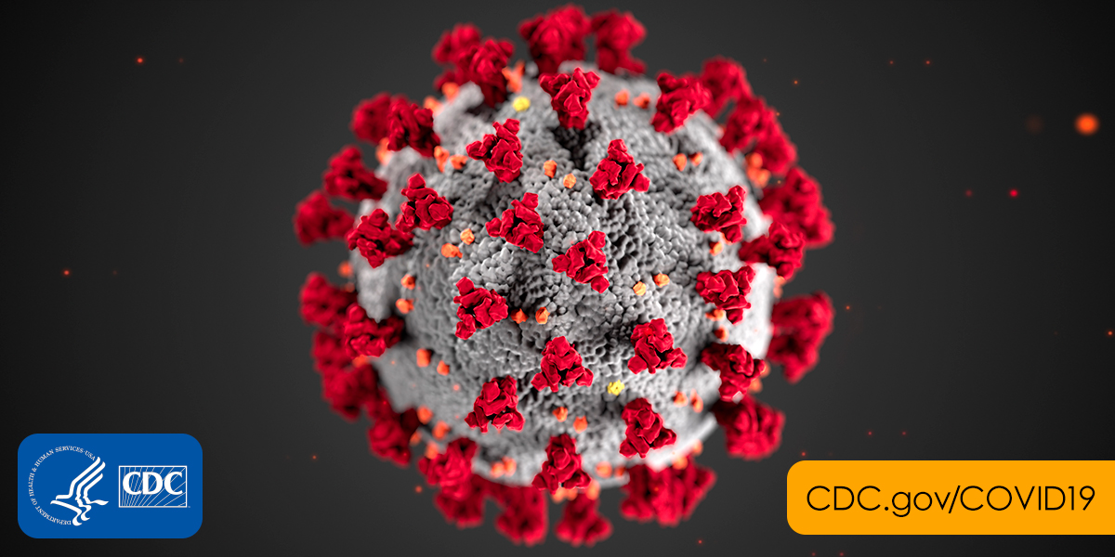
Outline
What is COVID-19?
Am I at risk?
COVID-19 is coming!
#FlattenTheCurve
How to Help

Slide 4
Outline
What is COVID-19?
Am I at risk?
COVID-19 is coming!
#FlattenTheCurve
How to Help

Slide 6
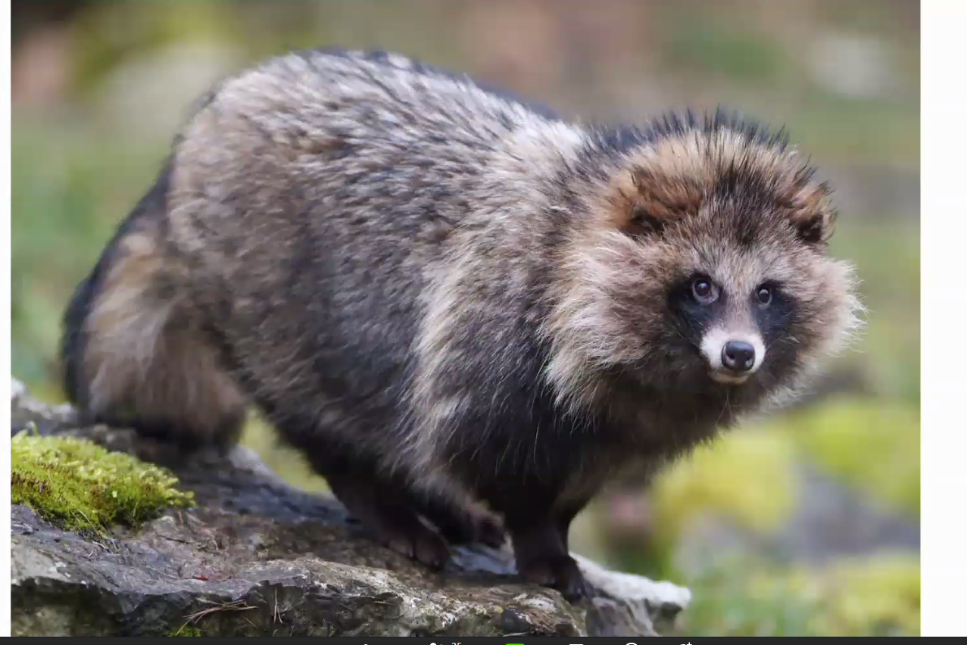
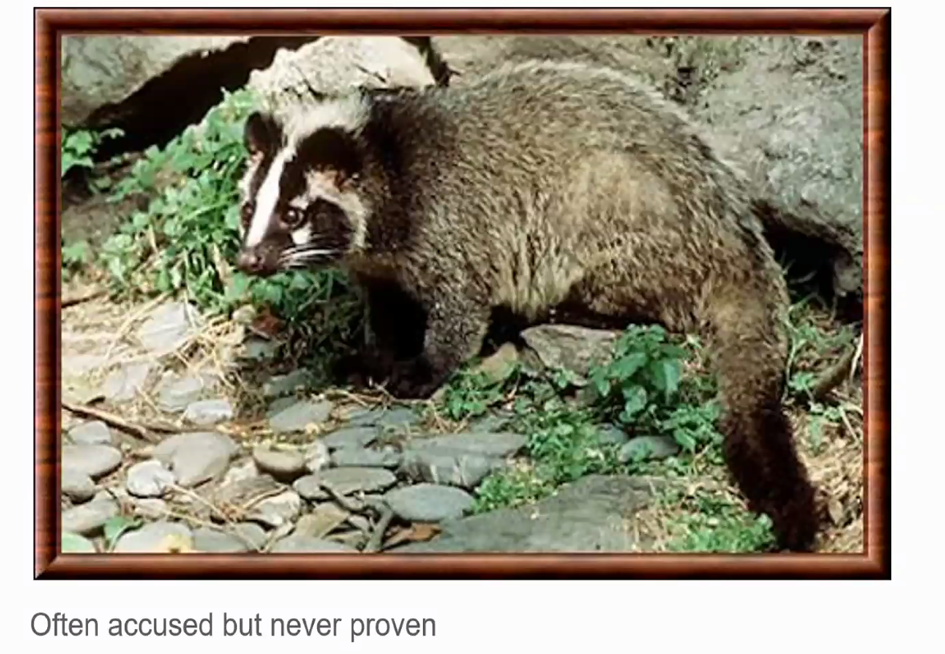
SARS-CoV-1 2002-2003
Severe Acute Respiratory Syndrome
First case was retrospectively recognized as having occurred in Nov 2002
By July 2003, international spread of SARS-CoV resulted in 8098 SARS cases in 26 countries, with 774 deaths
WHO reported the last human chain of transmission, and that the epidemic had been broken on 5 July 2003
The etiological agent, the SARS coronavirus (SARS-CoV) is believed to be an animal virus that crossed the species barrier, or changes in human behavior increased opportunities for human exposure to the virus. Virus adaptation enabled human-to-human transmission.

Slide 7
SARS-CoV-2 2019
SARS-COV-2 is the virus that causes COVID-19 disease
Symptoms:
Fever
Cough
Shortness of breath
GI disturbance
Warning signs
Trouble breathing
Persistent pain or pressure in the chest
New confusion or inability to arouse
Bluish lips or face

Slide 8
https://ourworldindata.org/coronavirus
Notes:
Current data

Slide 9
https://ourworldindata.org/coronavirus
DEATH

Slide 12
Outline
What is COVID-19?
Am I at risk?
Of death? (probably not)
Of critical illness? (possibly!)
COVID-19 is coming!
#FlattenTheCurve
How to Help

Slide 13
People at higher risk for severe illness (CDC)
People aged 65 years and older
Healthcare workers
Long-term care facilities, Nursing homes
High-risk conditions
Chronic lung disease, moderate to severe asthma
Serious heart conditions
Severe obesity (body mass index >= 40), or uncontrolled underlying medical conditions such as diabetes, renal failure, liver disease
Immunocompromised, including cancer treatment, smoking, bone marrow or other transplant, immune deficiencies, poorly controlled HIV or AIDS, prolonged use of corticosteroids
https://www.cdc.gov/coronavirus/2019-ncov/need-extra-precautions/people-at-higher-risk.html

Slide 15
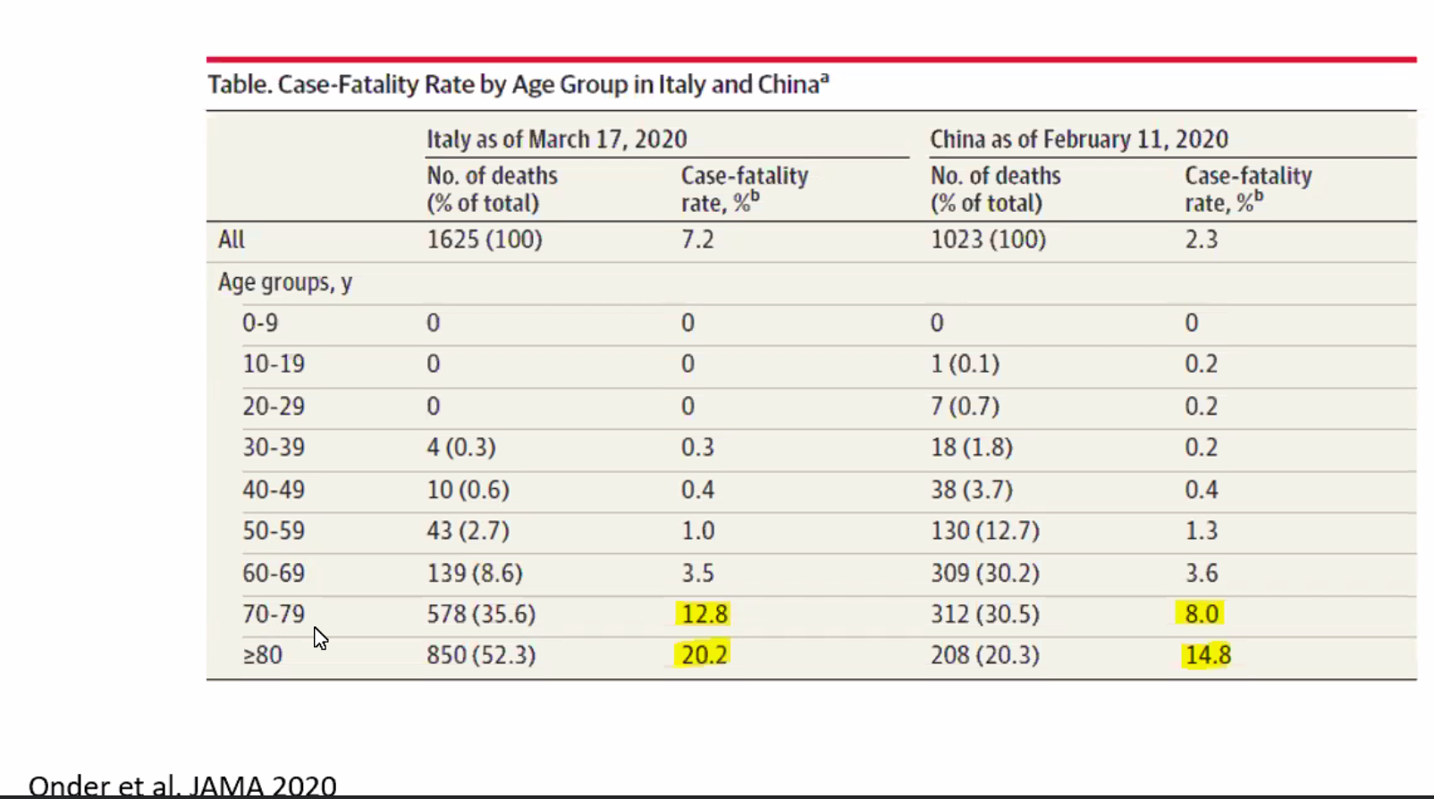

Slide 16
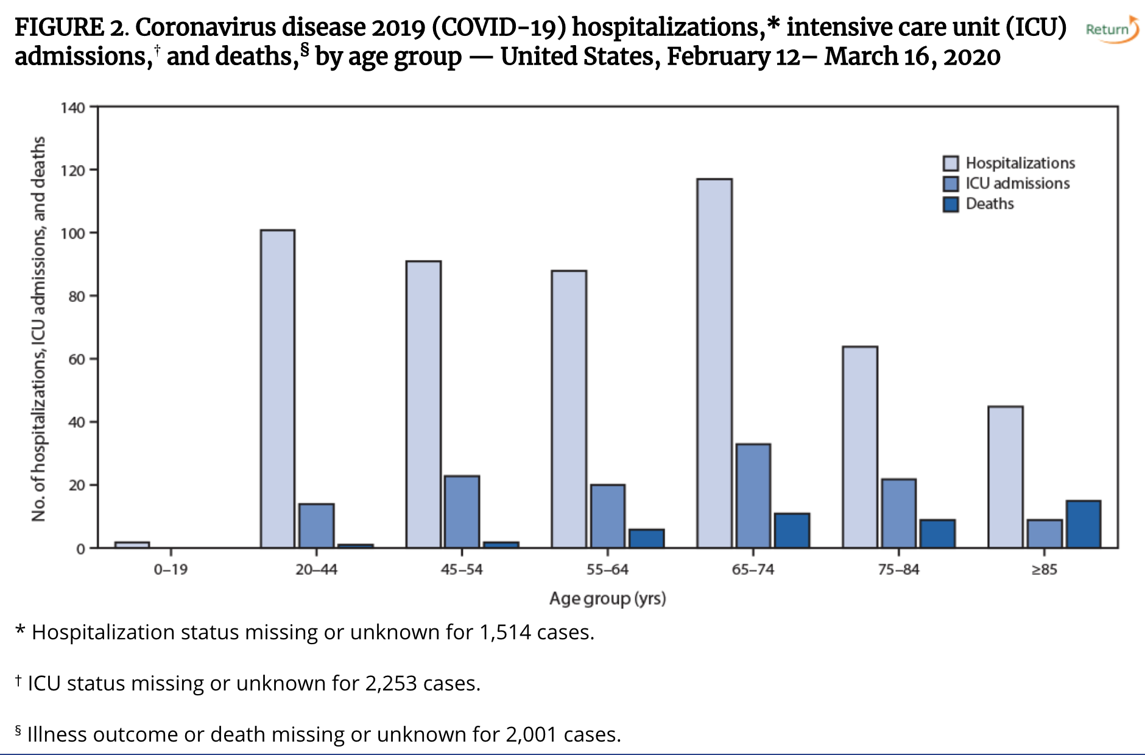
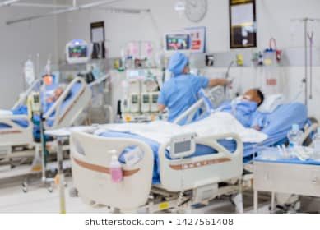
But even if you’re not at risk of death, you’re at risk of critical illness….

Slide 17
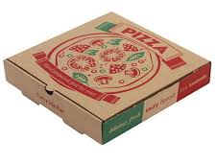
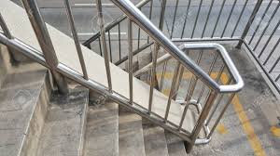
How long does COVID last on surfaces?
Cardboard
24 hours
Stainless Steel
24-48 hours
Plastic
48-72 hours
https://www.medrxiv.org/content/10.1101/2020.03.09.20033217v2

Slide 18
Outline
What is COVID-19?
Am I at risk?
COVID-19 is coming!
#FlattenTheCurve
How to Help

Slide 19
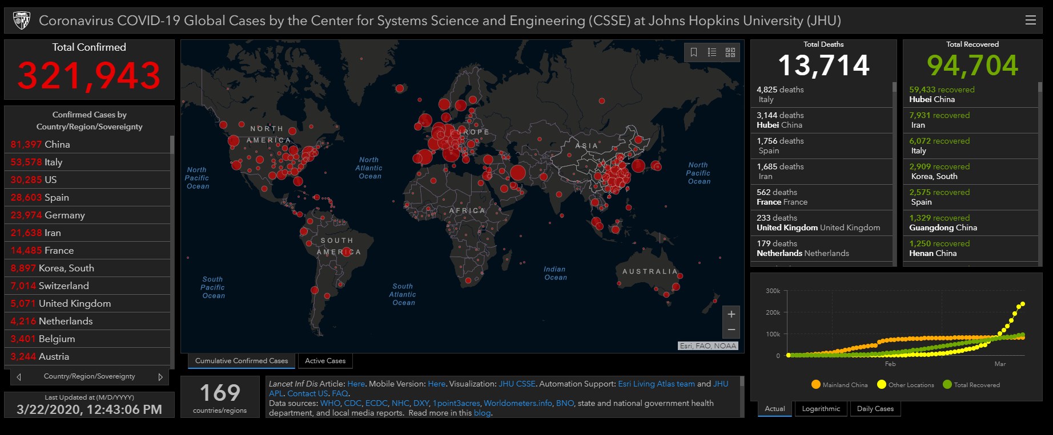
As of Sun 3/22/20 (10 days ago):

Slide 20
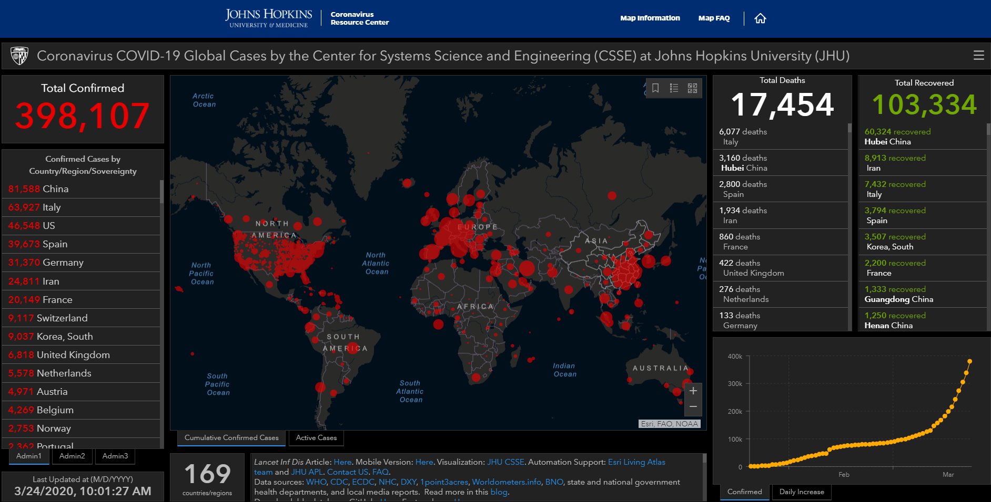
As of Tue 3/24/20 (8 days ago):

Slide 21
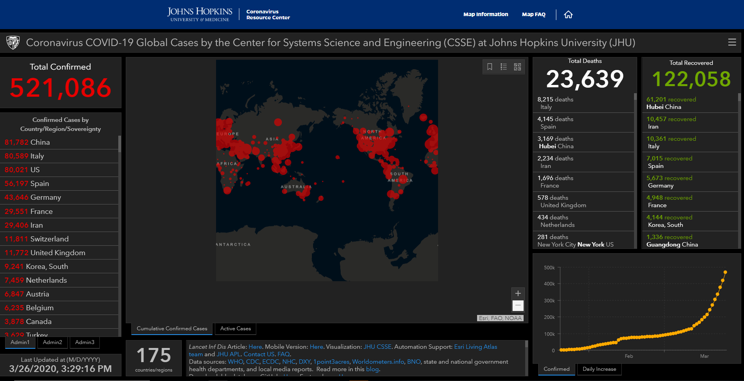
As of Thur 3/26/20 (6 days ago):

Slide 22
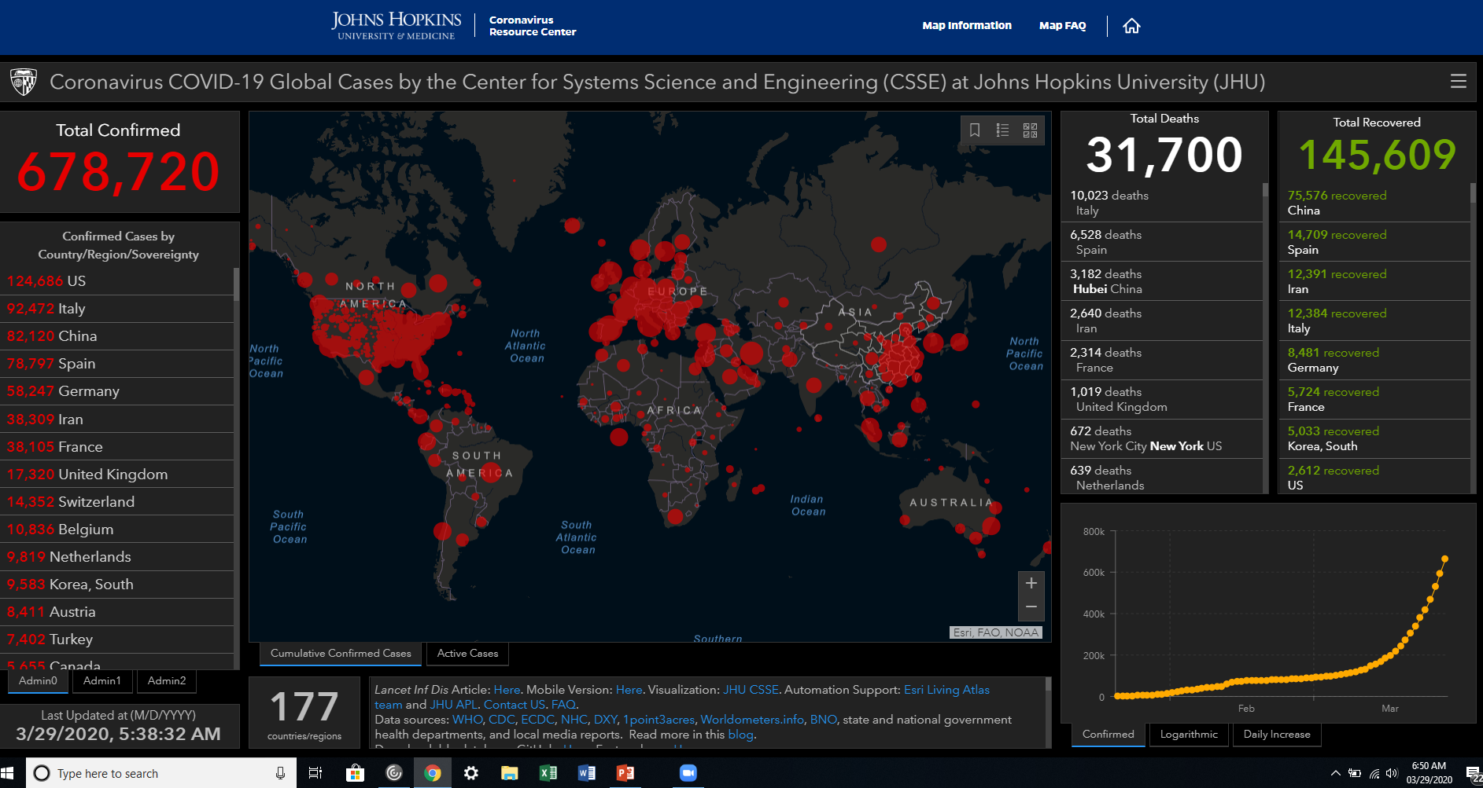
As of Sun 3/29/20 (3 days ago):

Slide 23
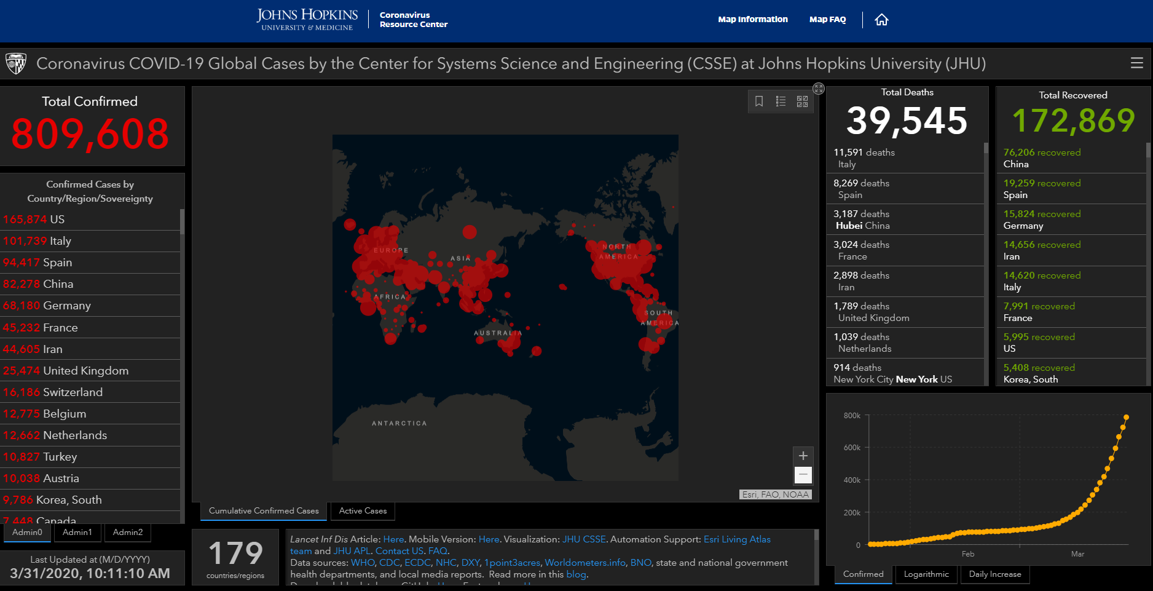
As of Tue 3/31/20 (yesterday):

Slide 24
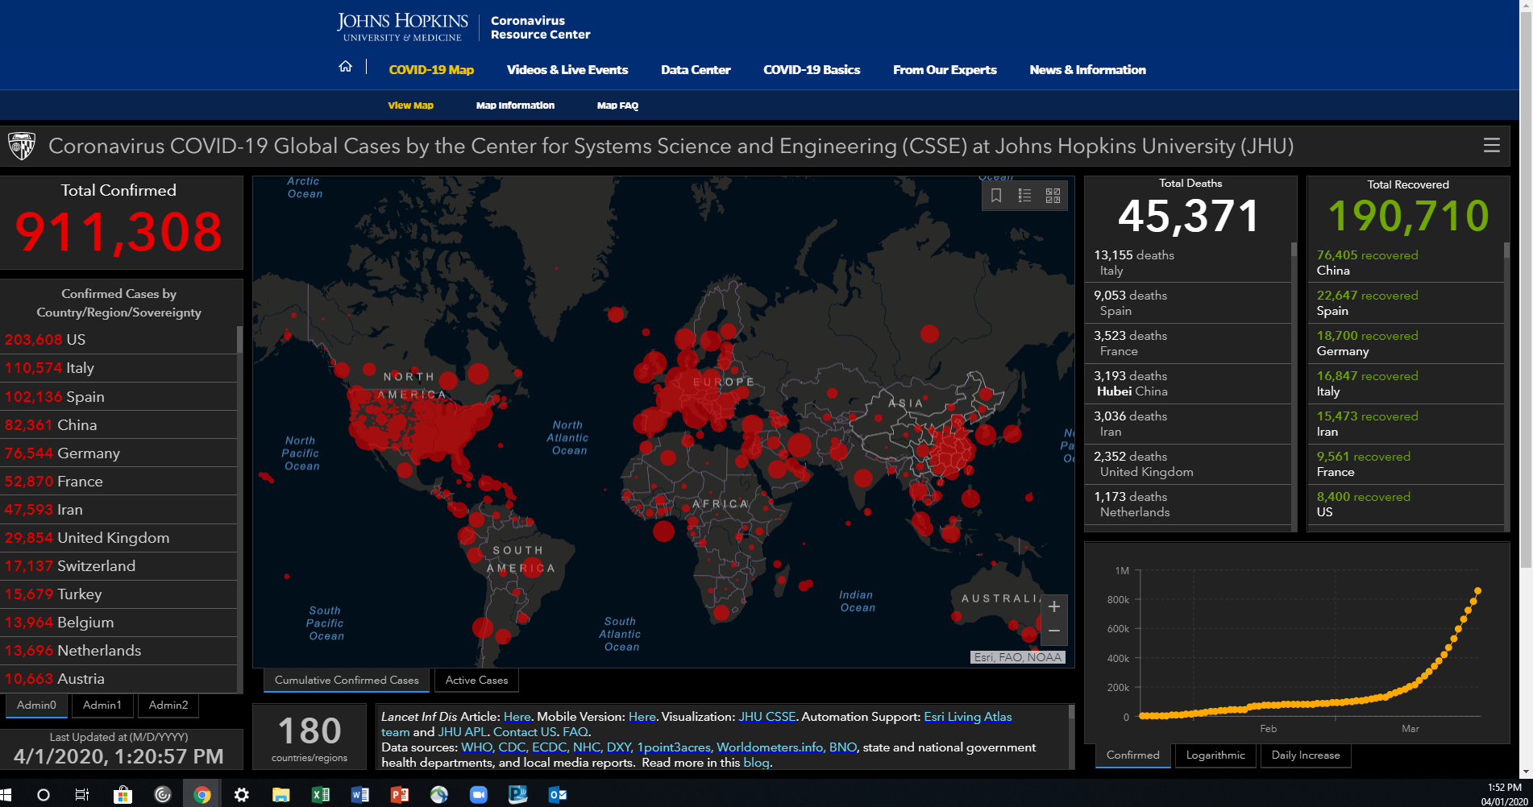
As of today at noon, Wed 4/1/20:

Slide 26
Columbia/Boone County Department of Public Health and Human Services End of Day Summary 3/21/20 (11 days ago)

Slide 27
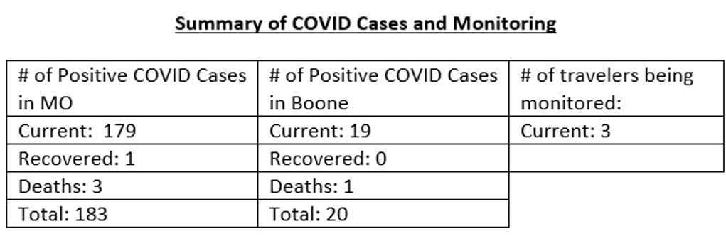
Columbia/Boone County Department of Public Health and Human Services End of Day Summary 3/23/20 (9 days ago)

Slide 28
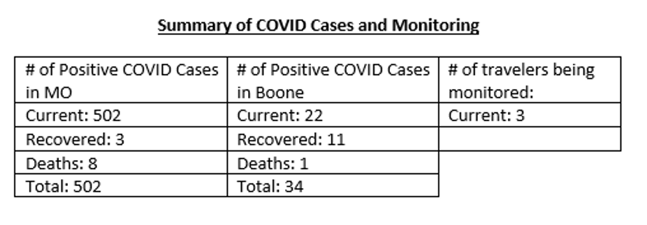
Columbia/Boone County Department of Public Health and Human Services End of Day Summary 3/26/20 (6 days ago)

Slide 29
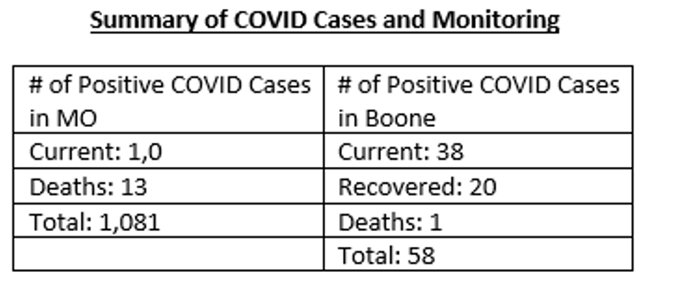
Columbia/Boone County Department of Public Health and Human Services End of Day Summary 3/30/20 (2 days ago)

Slide 30
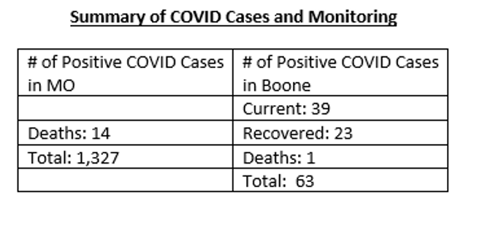
Columbia/Boone County Department of Public Health and Human Services End of Day Summary 3/31/20 (yesterday)

Slide 31
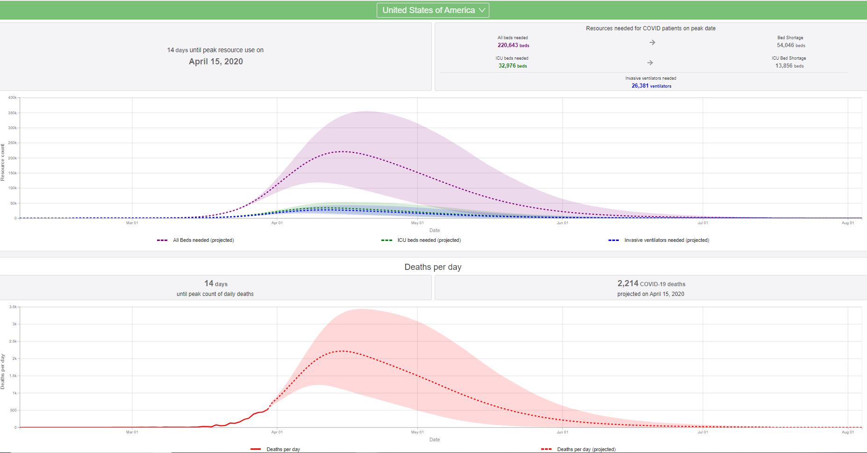
covid19.healthdata.org/projections

Slide 32
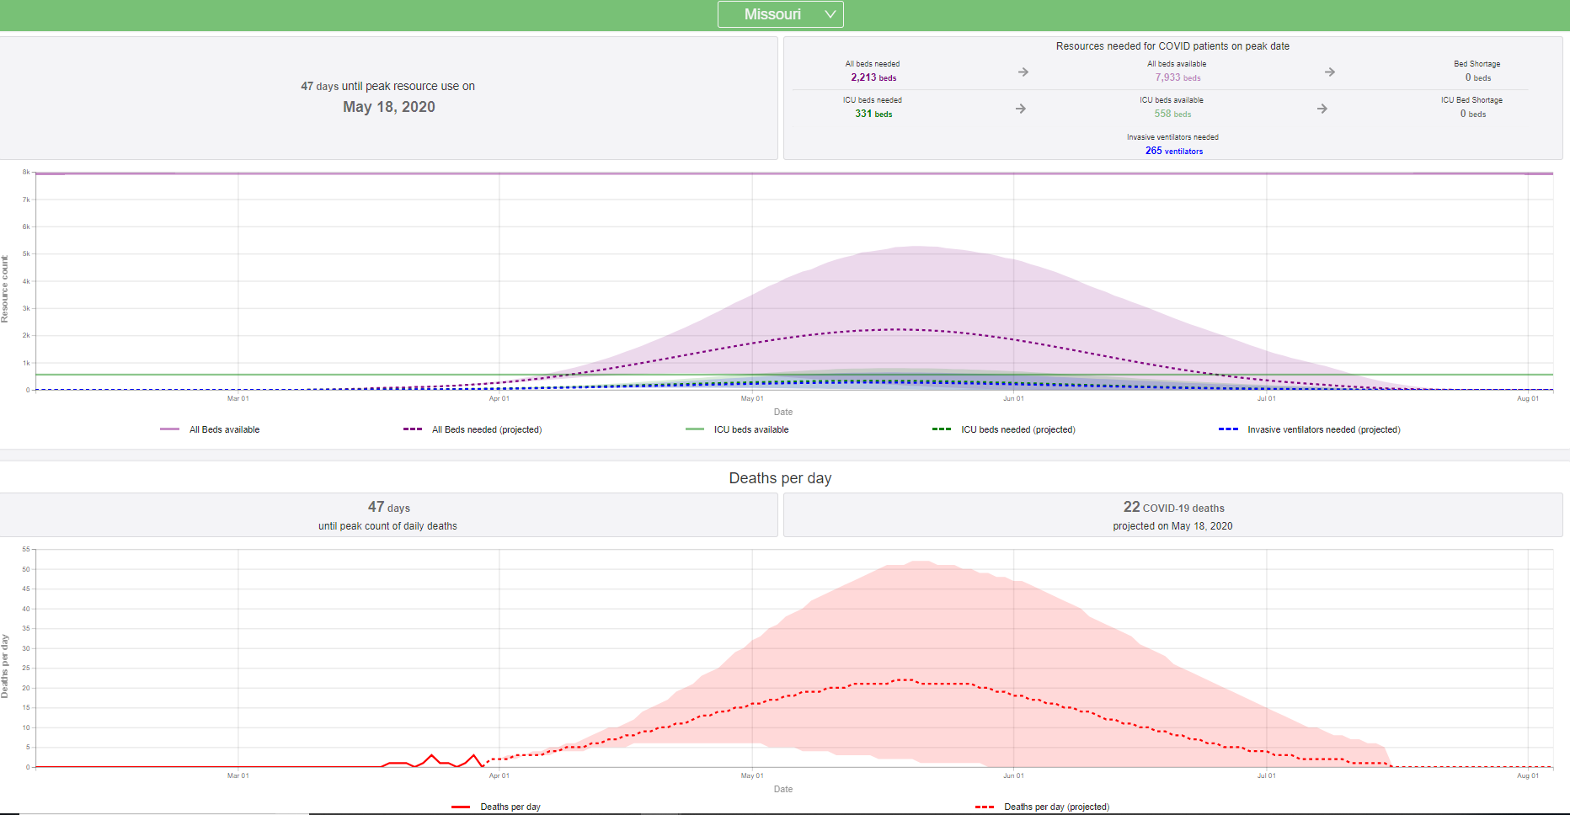
covid19.healthdata.org/projections

Slide 33
Outline
What is COVID-19?
Am I at risk?
COVID-19 is coming!
#FlattenTheCurve
How to Help

Slide 34
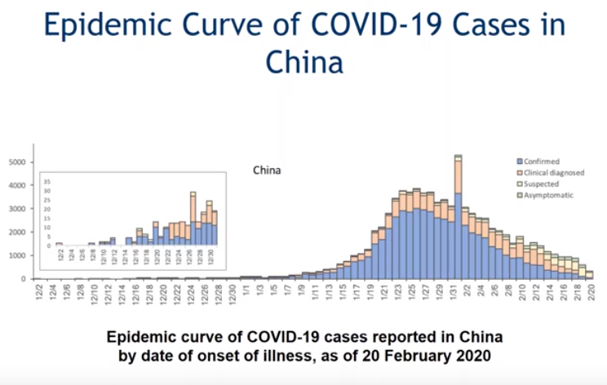
From Tue 3/10/20 webinar, Medical Society of Virginia:

Slide 35
From Tue 3/10/20 webinar, Medical Society of Virginia:

Slide 37
1918 Flu Pandemic: Effect of delaying preventative measures Philadelphia and St Louis
Notes:
St Louis managed to flatten their curve by implementing social distancing measures rapidly whereas Philadelphia decided to go ahead with a parade scheduled for Sept 28

Slide 38
Outline
What is COVID-19?
Am I at risk?
COVID-19 is coming!
#FlattenTheCurve
How to Help
1) Shelter-in-Place
2) como.gov => CoMoHelps.org
3) Stay current
4) Donate blood
5) Get organized

Slide 39
Outline
What is COVID-19?
Am I at risk?
COVID-19 is coming!
#FlattenTheCurve
How to Help
1) Shelter-in-Place
2) como.gov => CoMoHelps.org
3) Stay current
4) Donate blood
5) Get organized

Slide 40
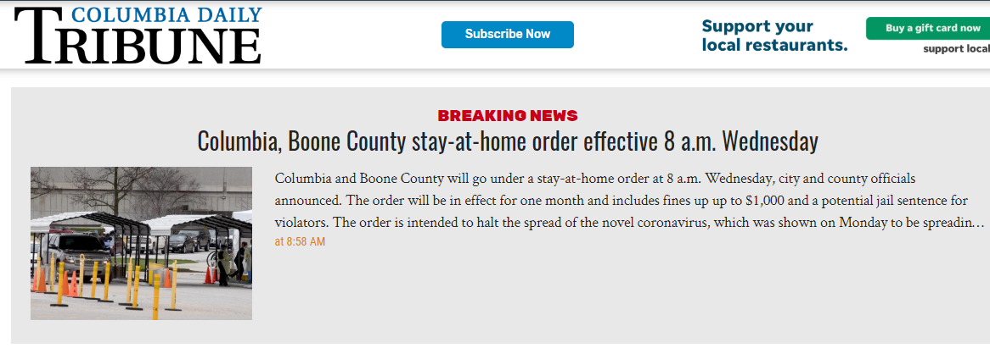

Slide 41
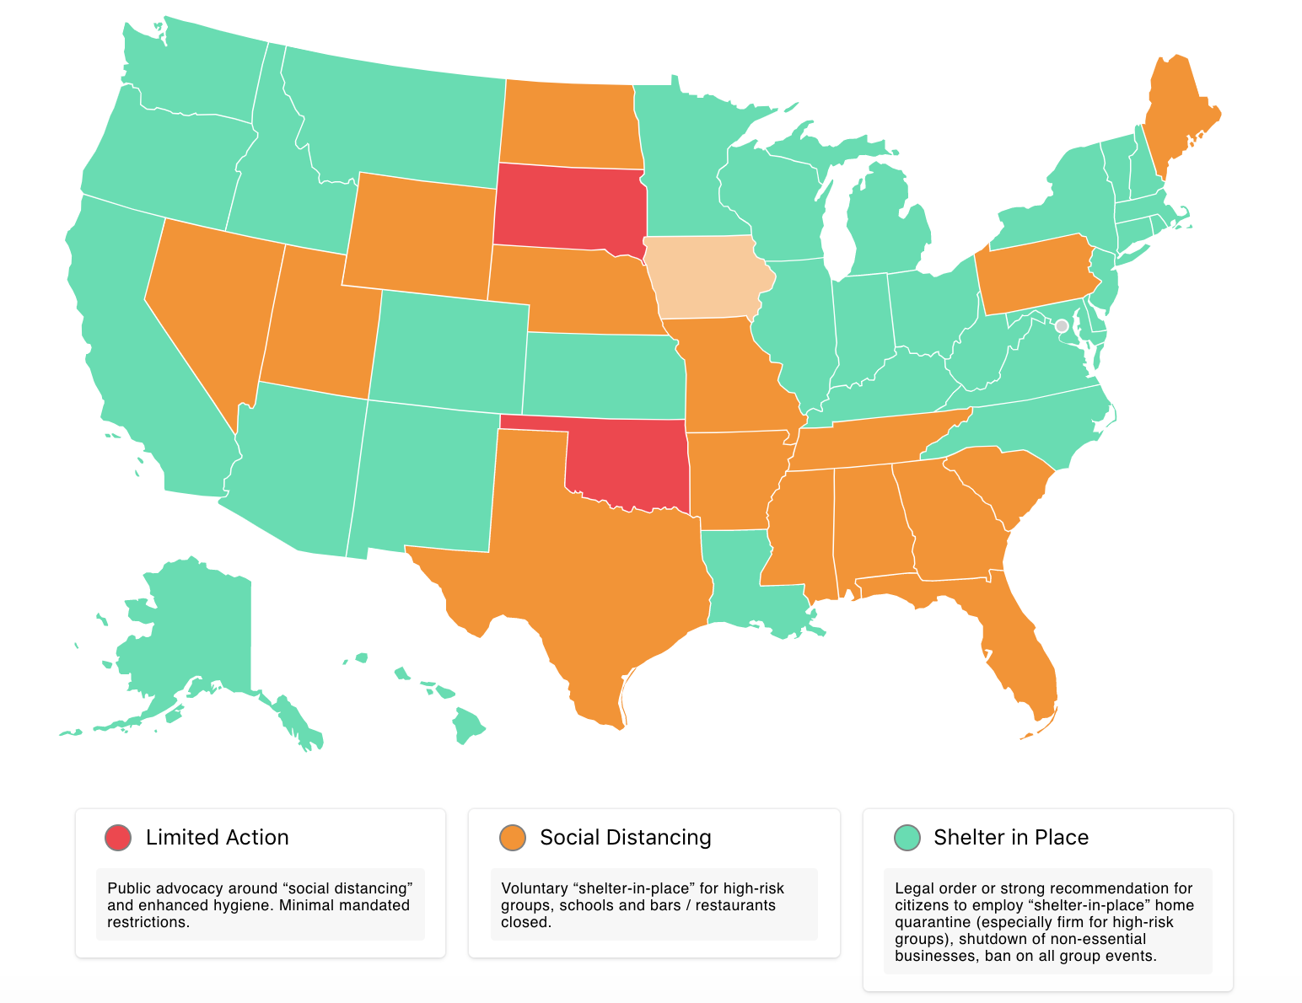

Slide 42
Notes:
New Image

Slide 43
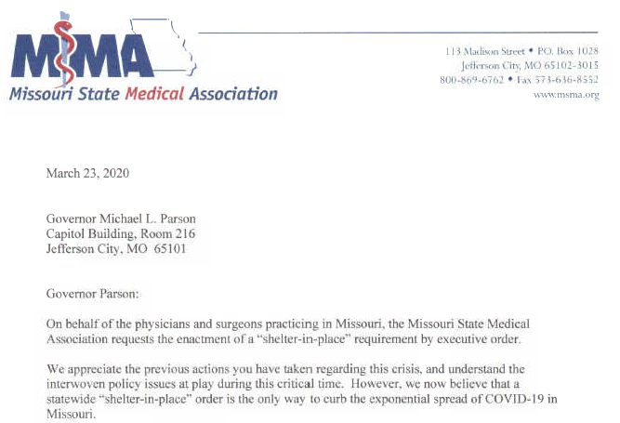

Slide 44
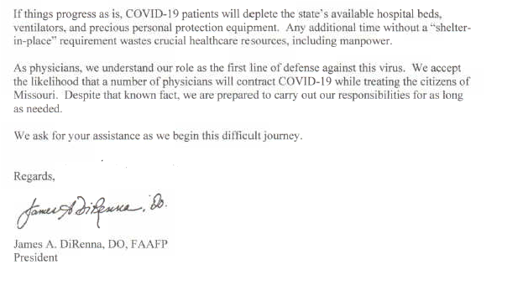

Slide 45
Outline
What is COVID-19?
Am I at risk?
COVID-19 is coming!
#FlattenTheCurve
How to Help
1) Shelter-in-Place
2) como.gov => CoMoHelps.org
3) Stay current
4) Donate blood
5) Get organized

Slide 46
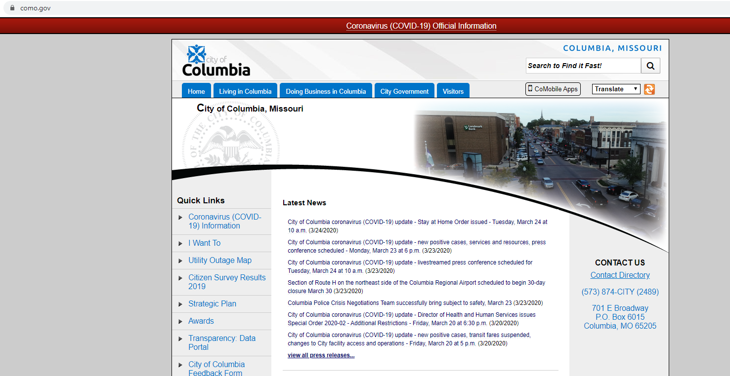
Student volunteer opportunities
For general volunteers: go to como.gov, click on “coronavirus official info”

Slide 47
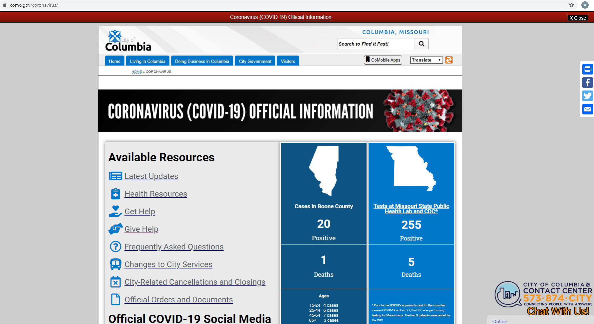
Student volunteer opportunities
For general volunteers: goto como.gov, click on “coronavirus official info” => then click on “give help”

Slide 48
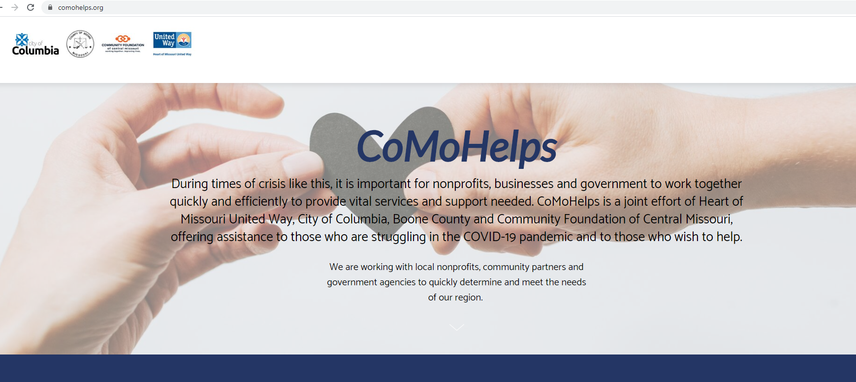
Student volunteer opportunities
For general volunteers: goto como.gov, click on “coronavirus official info” => then click on “give help” => that redirects you to “CoMoHelps” webpage

Slide 49
Caution
Caution: beware of volunteer opportunities that may violate “social distancing” recommendations – check with your faculty first!

Slide 50
Outline
What is COVID-19?
Am I at risk?
COVID-19 is coming!
#FlattenTheCurve
How to Help
1) Shelter-in-Place
2) como.gov => CoMoHelps.org
3) Stay current
4) Donate blood
5) Get organized

Slide 51
Helpful websites
City of Columbia: https://www.como.gov/coronavirus/
Missouri DHSS: https://health.mo.gov/
BCMS: https://www.boonecountymedicalsociety.org/covid-19-resources.html
MSMA: https://www.msma.org/coronavirus-2019-covid-19.html
AMA: https://www.ama-assn.org/delivering-care/public-health/covid-19-2019-novel-coronavirus-resource-center-physicians

Slide 52
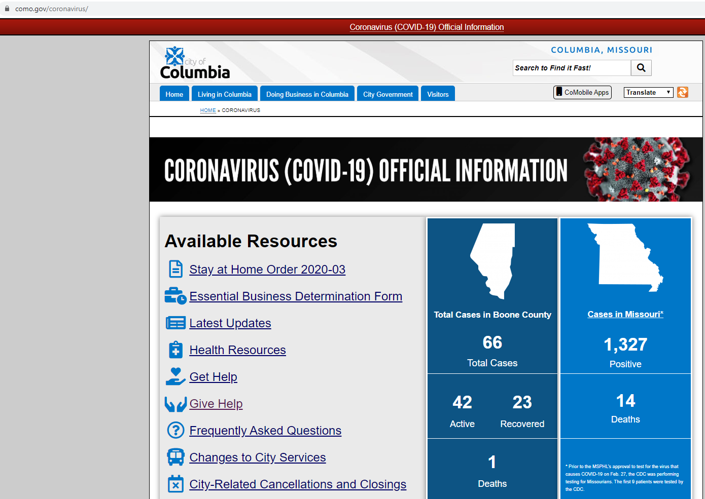

Slide 53
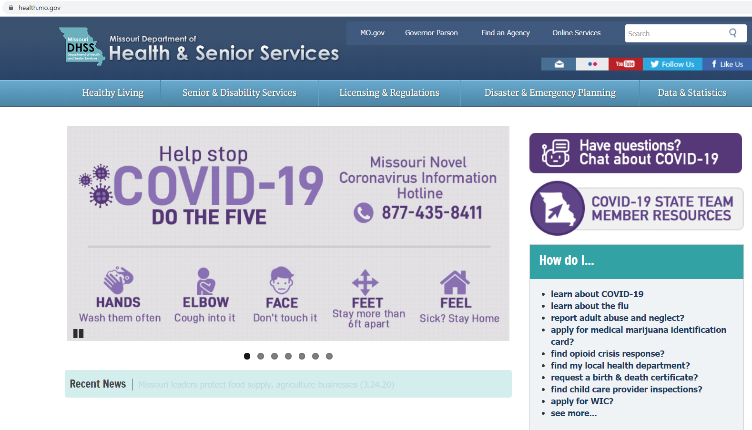

Slide 54
Helpful websites
City of Columbia: https://www.como.gov/coronavirus/
Missouri DHHS: https://health.mo.gov/
BCMS: https://www.boonecountymedicalsociety.org/covid-19-resources.html
MSMA: https://www.msma.org/coronavirus-2019-covid-19.html
AMA: https://www.ama-assn.org/delivering-care/public-health/covid-19-2019-novel-coronavirus-resource-center-physicians

Slide 55
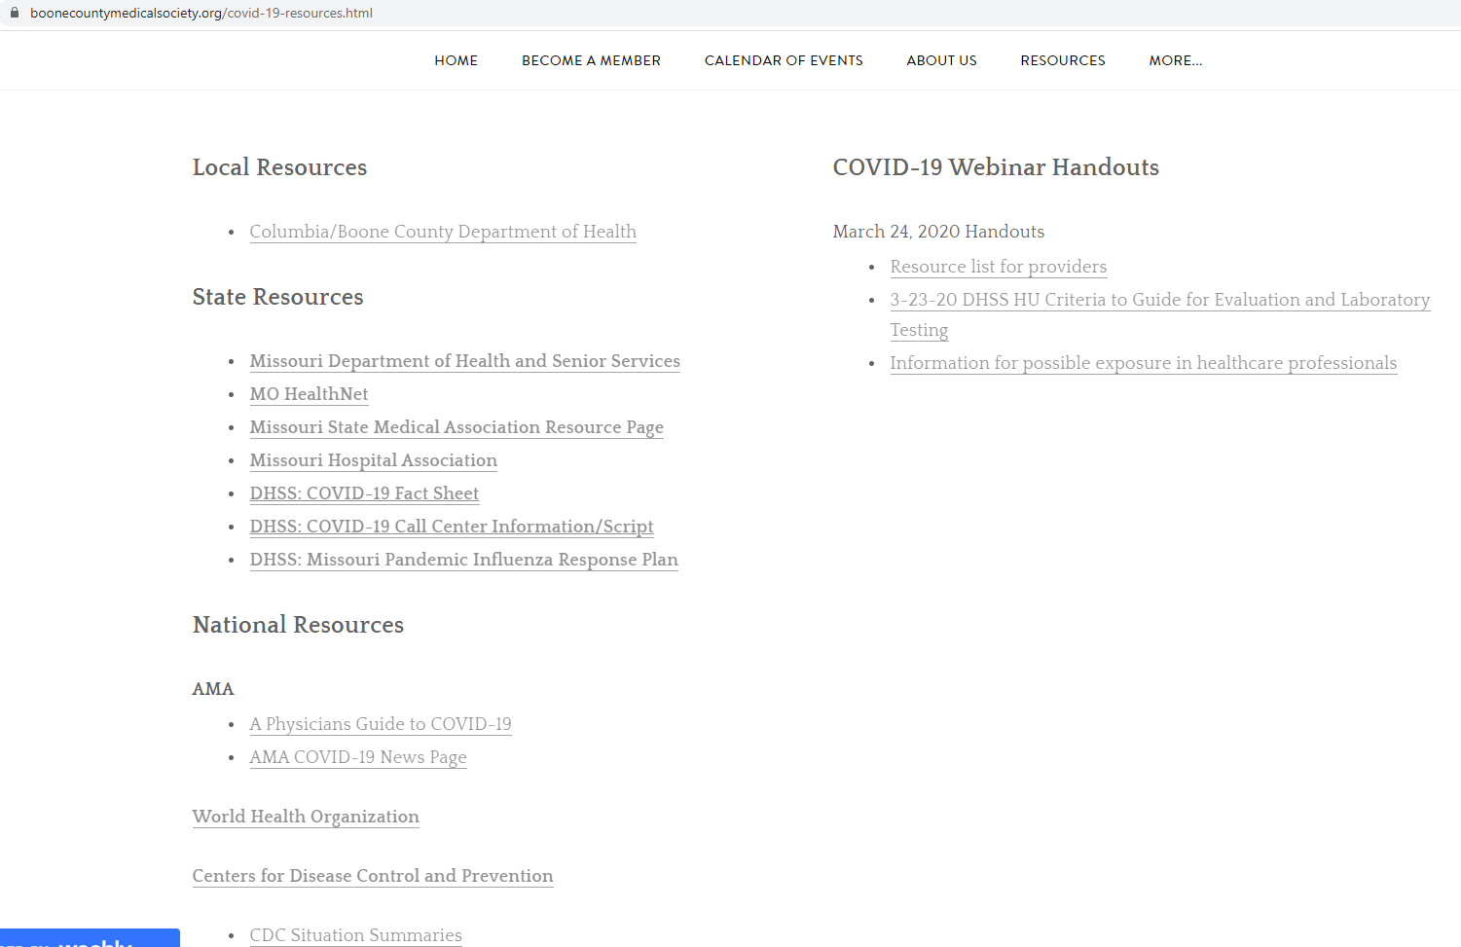

Slide 56
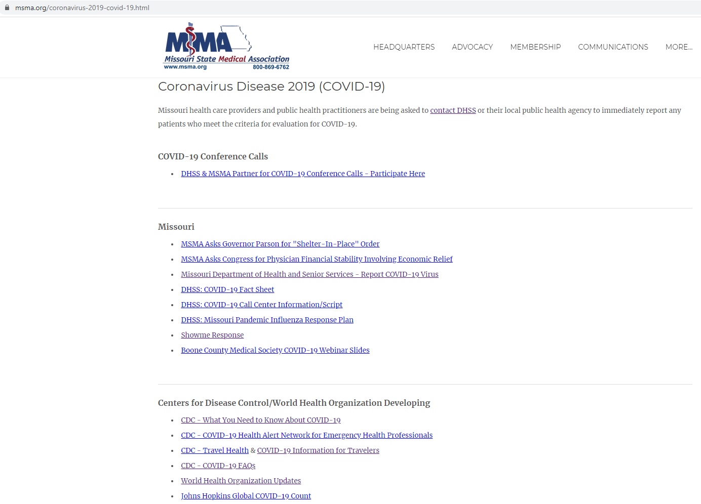

Slide 57
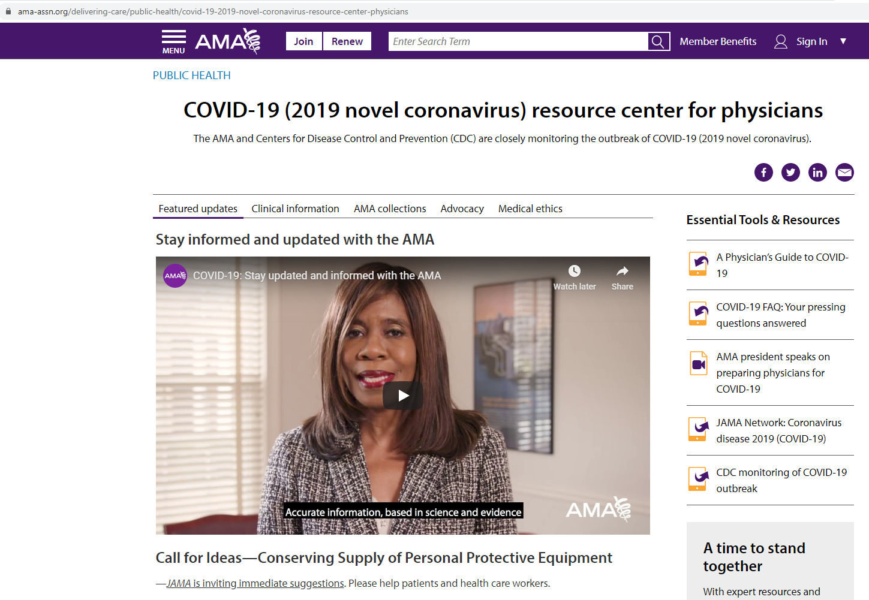

Slide 58
Outline
What is COVID-19?
Am I at risk?
COVID-19 is coming!
#FlattenTheCurve
How to Help
1) Shelter-in-Place
2) como.gov => CoMoHelps.org
3) Stay current
4) Donate blood -> please visit your American Red Cross
5) Get organized

Slide 60
Outline
What is COVID-19?
Am I at risk?
COVID-19 is coming!
#FlattenTheCurve
How to Help
1) Shelter-in-Place
2) como.gov => CoMoHelps.org
3) Stay current
4) Donate blood
5) Get organized

Slide 61
Get organized!
Suggested Principles for student volunteers:
(1) School responsibilities first! Do well on your exams, school requirements.
(2) Let’s anticipate that our response to Coronavirus will go on for weeks-to-months.
(3) Many of us are going to get sick or may need to take time off to help care for friends and family. Some students will graduate soon. Succession planning is key in a crisis.

Slide 62
Find a faculty advisor/mentor/advocate
Options for organized volunteer efforts
(1) Lobbying
(2) Sharing stories
(3) Community support
(4) Social media
Cautions: beware of volunteer opportunities that may violate “social distancing” recommendations – check with your faculty first!

Slide 63
Disclosures / Disclaimers
Please understand that this information is constantly-evolving.
Pandemics are difficult to model and predict.
Some “facts” stated just last week, may now be out-of-date.
I AM NOT YOUR DOCTOR.
Please see your primary care provider for any personal medical questions.
Today’s town hall is a general informational session to the Mizzou student community.
I will direct you to official websites (like CDC) for public health recommendations.

Slide 64
Summary
1.) For those panicked about COVID-19, people your age are unlikely to die from this.

Slide 65
Summary
1.) For those panicked about COVID-19, people your age are unlikely to die from this.
2.) For those who are nonchalant and overly complacent about this worldwide pandemic, please be aware that some unlucky younger folks are sometimes getting critically ill, and needing oxygen or even ICU-level care from COVID-19.

Slide 66
Summary
3.) For everyone, the main reason for cancelling sports events, closing schools/churches, and encouraging social distancing is to #FlattenTheCurve, to protect the elderly *and* your healthcare workers on the front lines.
Your nurses, doctors, and first responders are out there protecting you; please help protect us by slowing the spread.

Slide 67
Summary
4.) COVID-19 is coming.
I would argue that our goal is not to remain disease-free forever, but to slow the spread so as to not overwhelm our healthcare system.
COVID-19 is currently hitting urban centers and then spreading out from there, so many of us anticipate a surge of cases in Missouri, over the coming weeks.

Slide 68
Summary
5.) It’s probably not the best time to be in a motor vehicle accident in Italy. Or to need ICU care in Italy. Not right now.
Please don’t do stupid stuff.

Slide 69
Listen to your mother!!
Wash your hands.
Don’t do stupid stuff.

Slide 71
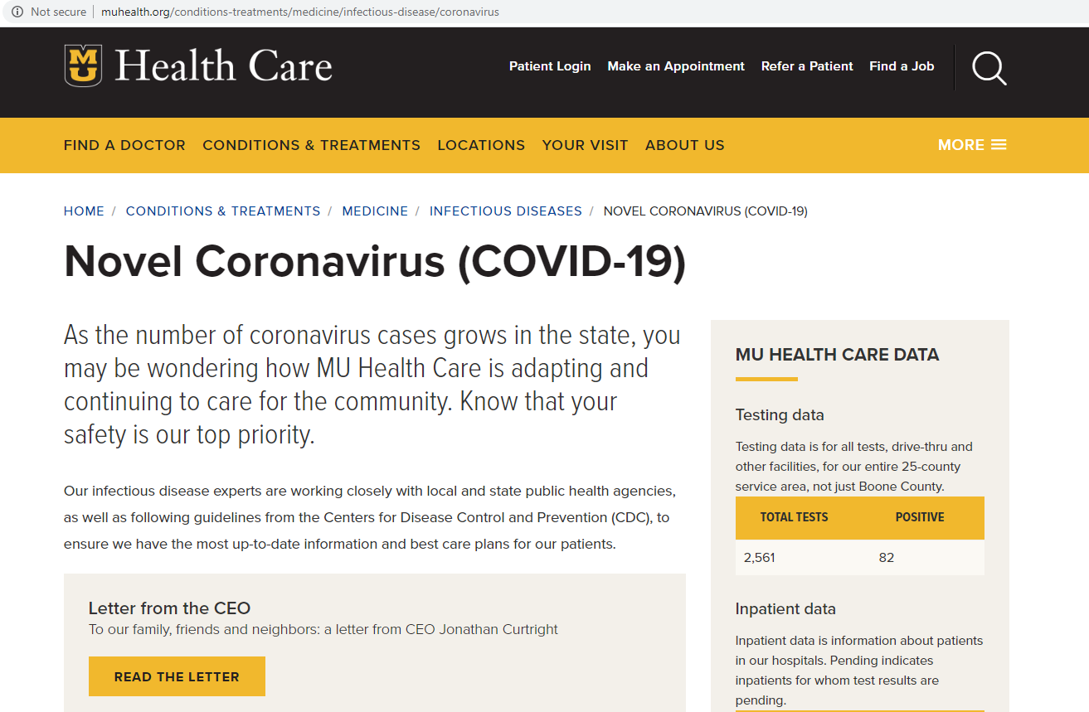

Slide 72
For more information, e-mail bcms@socket.net or goto:
https://health.mo.gov/
https://www.como.gov/coronavirus/
https://www.boonecountymedicalsociety.org/covid-19-resources.html
https://www.msma.org/coronavirus-2019-covid-19.html
https://www.ama-assn.org/delivering-care/public-health/covid-19-2019-novel-coronavirus-resource-center-physicians

